Slide 1
Wireless Communication System with Encryption
110064521 江威霖
110064513 陳思熙
110061560 吳秉豐

Slide 2
Outline
Introduction
System Architecture
Algorithm
HLS Implementation
Analysis
Conclusion
Reference
GitHub Link

Slide 3
Outline
Introduction
System Architecture
Algorithm
HLS Implementation
Analysis
Conclusion
Reference
GitHub Link

Slide 4
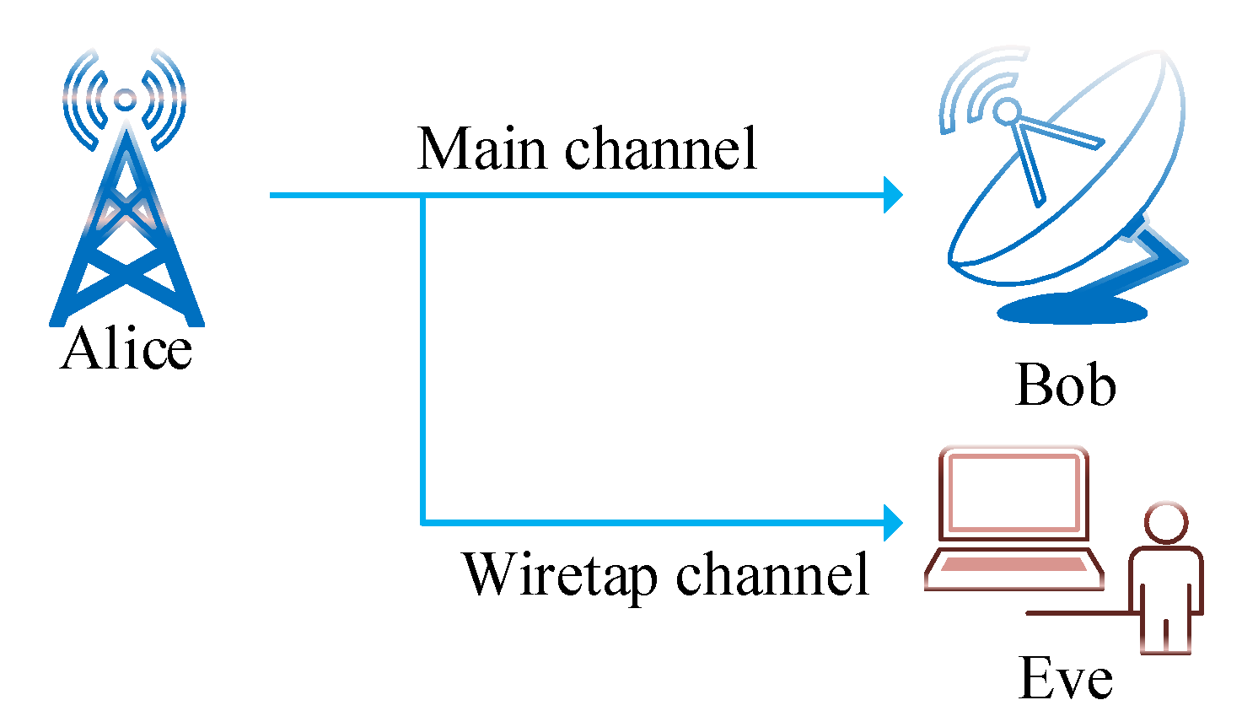
Introduction
Nowadays, due to the popularity of mobile devices, information or files are frequently transmitted through wireless communication systems, so it is an inevitable trend to encrypt users' privacy.
Notes:
由於移動設備的普及，信息或文件經常通過無線通信系統傳輸，因此對用戶隱私進行加密是必然趨勢，所以我們嘗試著用HLS，建構一個完整的通訊系統，搭配上AES128加密演算法，，使用U50加速板驗證在多天線的系統下，有無加密演算法的接收端訊號的差別，並且針對其效能進行優化。

Slide 5
Outline
Introduction
System Architecture
Algorithm
HLS Implementation
Analysis
Conclusion
Reference
GitHub Link

Slide 6
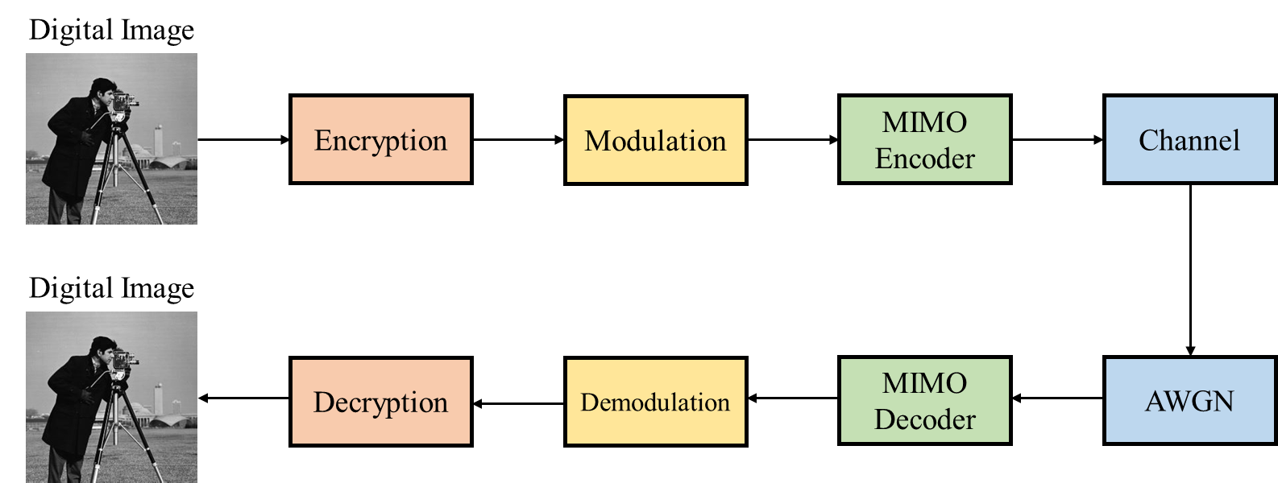
System Architecture

Slide 7
Outline
Introduction
System Architecture
Algorithm
HLS Implementation
Analysis
Conclusion
Reference
GitHub Link

Slide 8
AES-128
AES (Advanced Encryption Standard) is based on a design principle known as a substitution–permutation network, and is efficient in both software and hardware.
The design and strength of all key lengths of the AES algorithm are sufficient to protect classified information up to the top level.
AES could be divided into four main functions
SubBytes
ShiftRows
MixColumns
AddRoundKey
Notes:
AES 又稱RIJNDAEL 密碼演算法
是作為取代DES的 加密演算法
#原理
AES是一種 對稱 分組的密碼演算法
數據長度一般定義為 128, 192, 256 bits

Slide 9
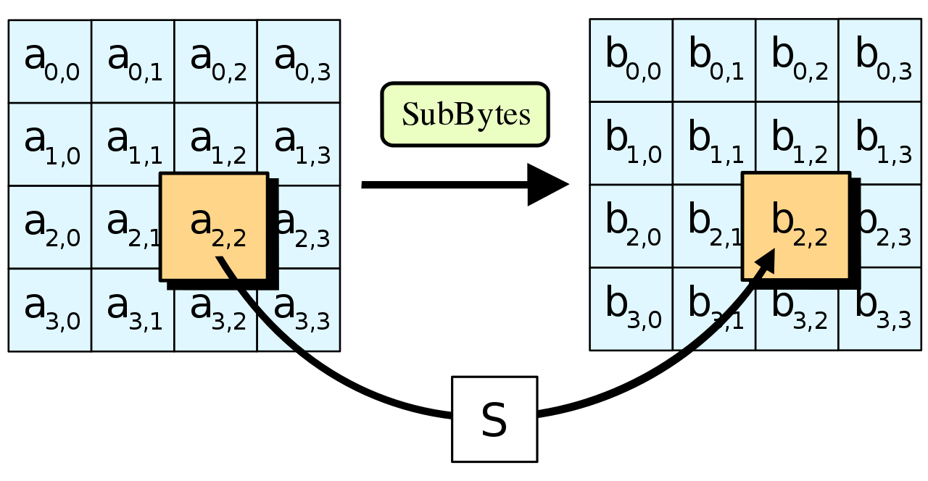
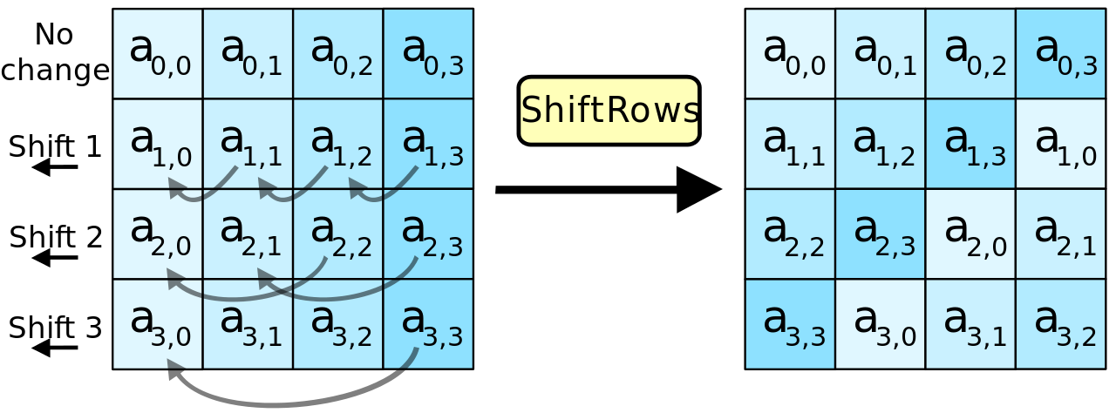
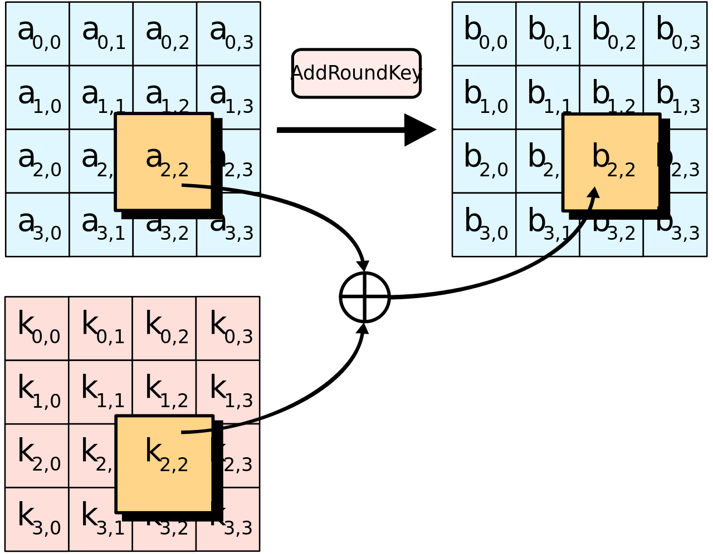
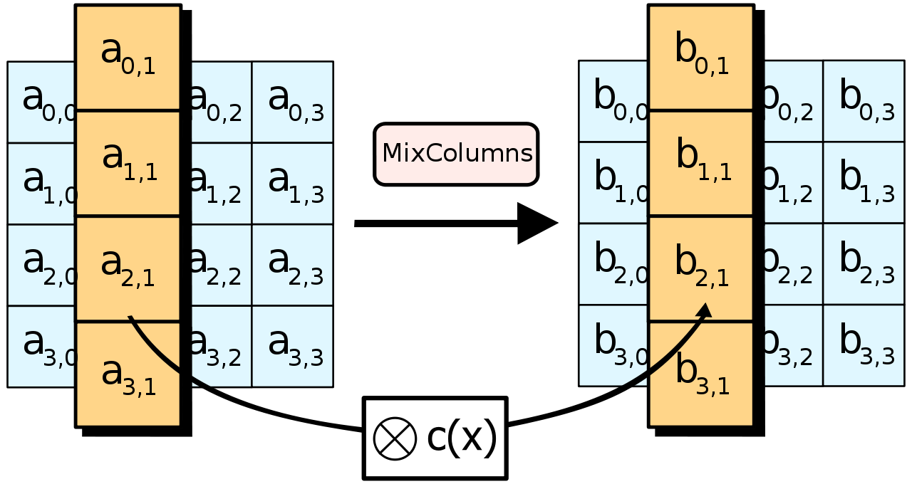
AES-128

Slide 10
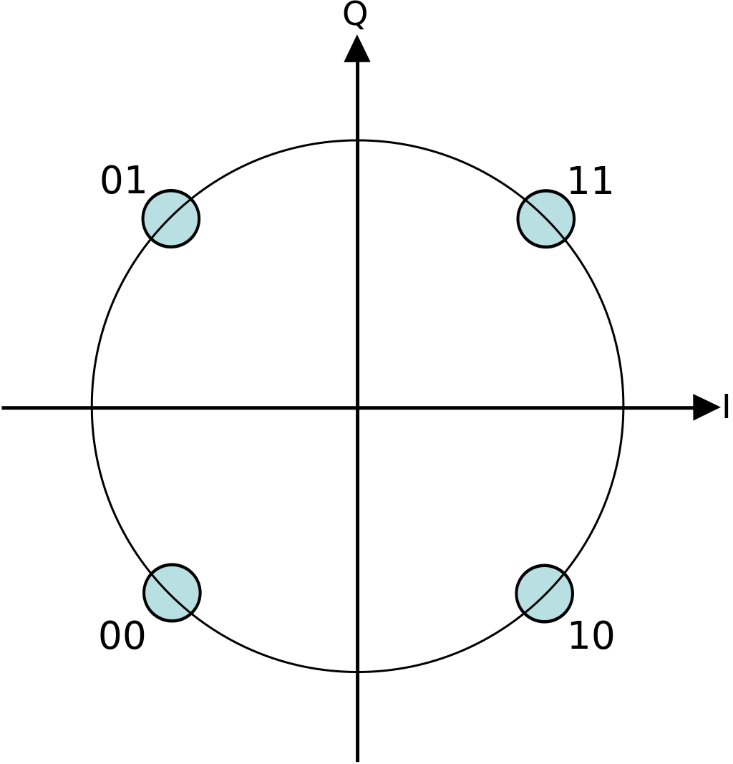
QPSK
QPSK(Quadrature phase-shift keying) is known as quadriphase PSK, 4-PSK, or 4-QAM.
QPSK uses four points on the constellation diagram, equispaced around a circle. With four phases, QPSK can encode two bits per symbol, shown in the diagram with Gray coding to minimize the BER (bit error rate)

Slide 11
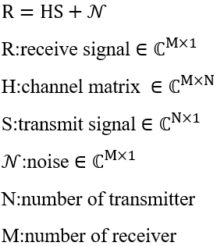
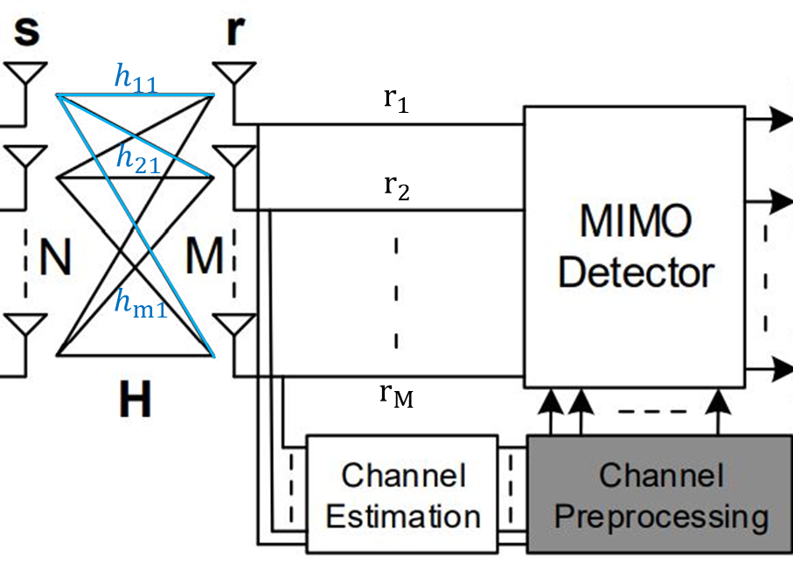
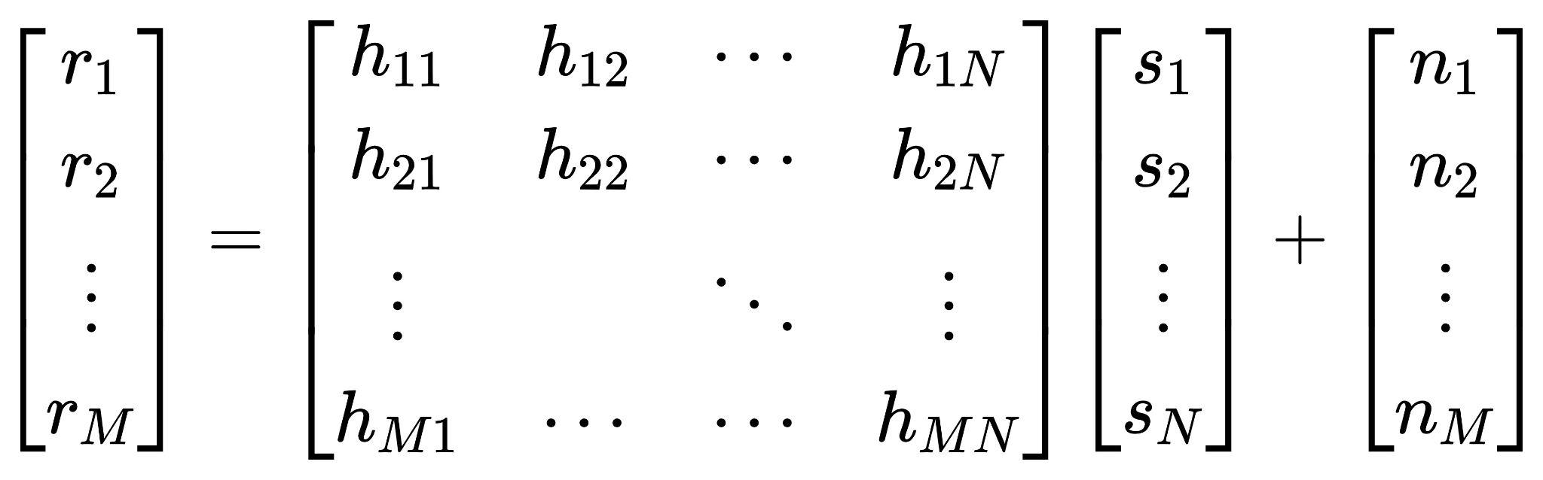
MIMO
Notes:
要多加上noise

Slide 12
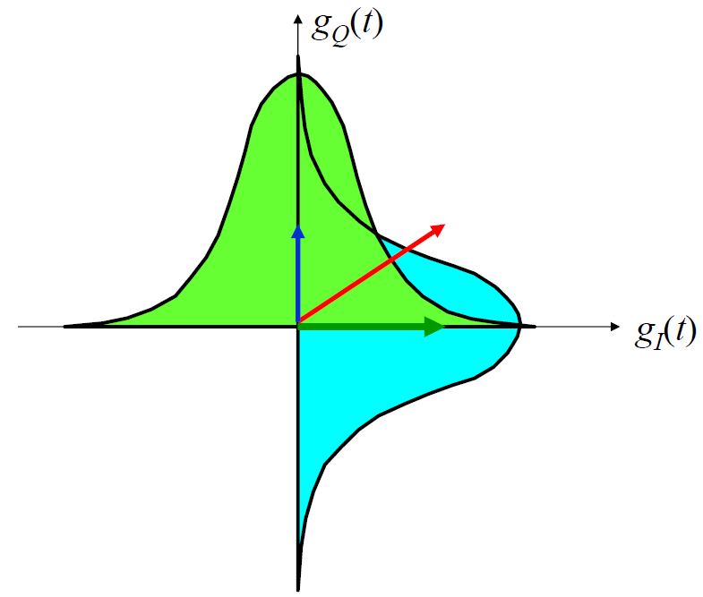
Rayleigh Fading Channel
Rayleigh fading is a channel model when there are many objects in the environment that scatter the radio signal before it arrives at the receiver.
The Central Limit Theorem holds that, if there is sufficiently much scatter, the channel impulse response will be well-modelled as a Gaussian process irrespective of the distribution of the individual components.
If there is no dominant component to the scatter, then such a process will have zero mean and phase evenly distributed between 0 and 2π radians.

Slide 13
AWGN
AWGN (Additive White Gaussian Noise) is a basic noise model used in information theory to mimic the effect of many random processes that occur in nature.
Additive : Because it is added to any noise that might be intrinsic to the information system.
White : White refers to the idea that it has uniform power across the frequency band for the information system. It is an analogy to the color white which has uniform emissions at all frequencies in the visible spectrum.
Gaussian : Because it has a normal distribution in the time domain with an average time domain value of zero.
Notes:
n是測試次數的感覺

Slide 14
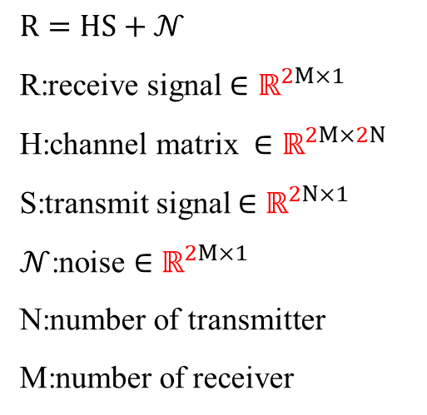
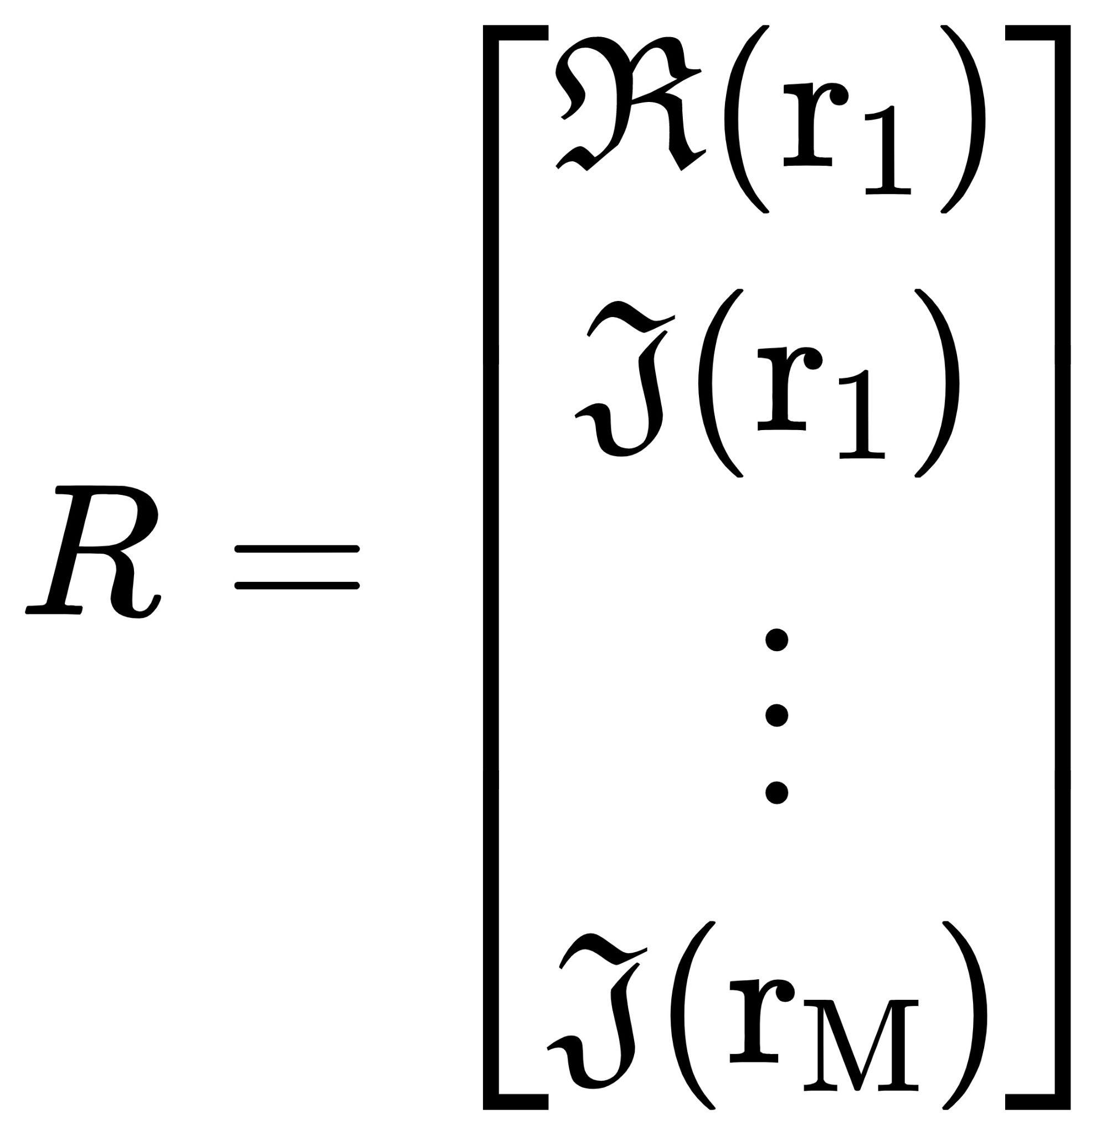
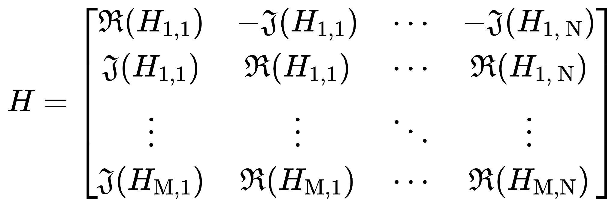
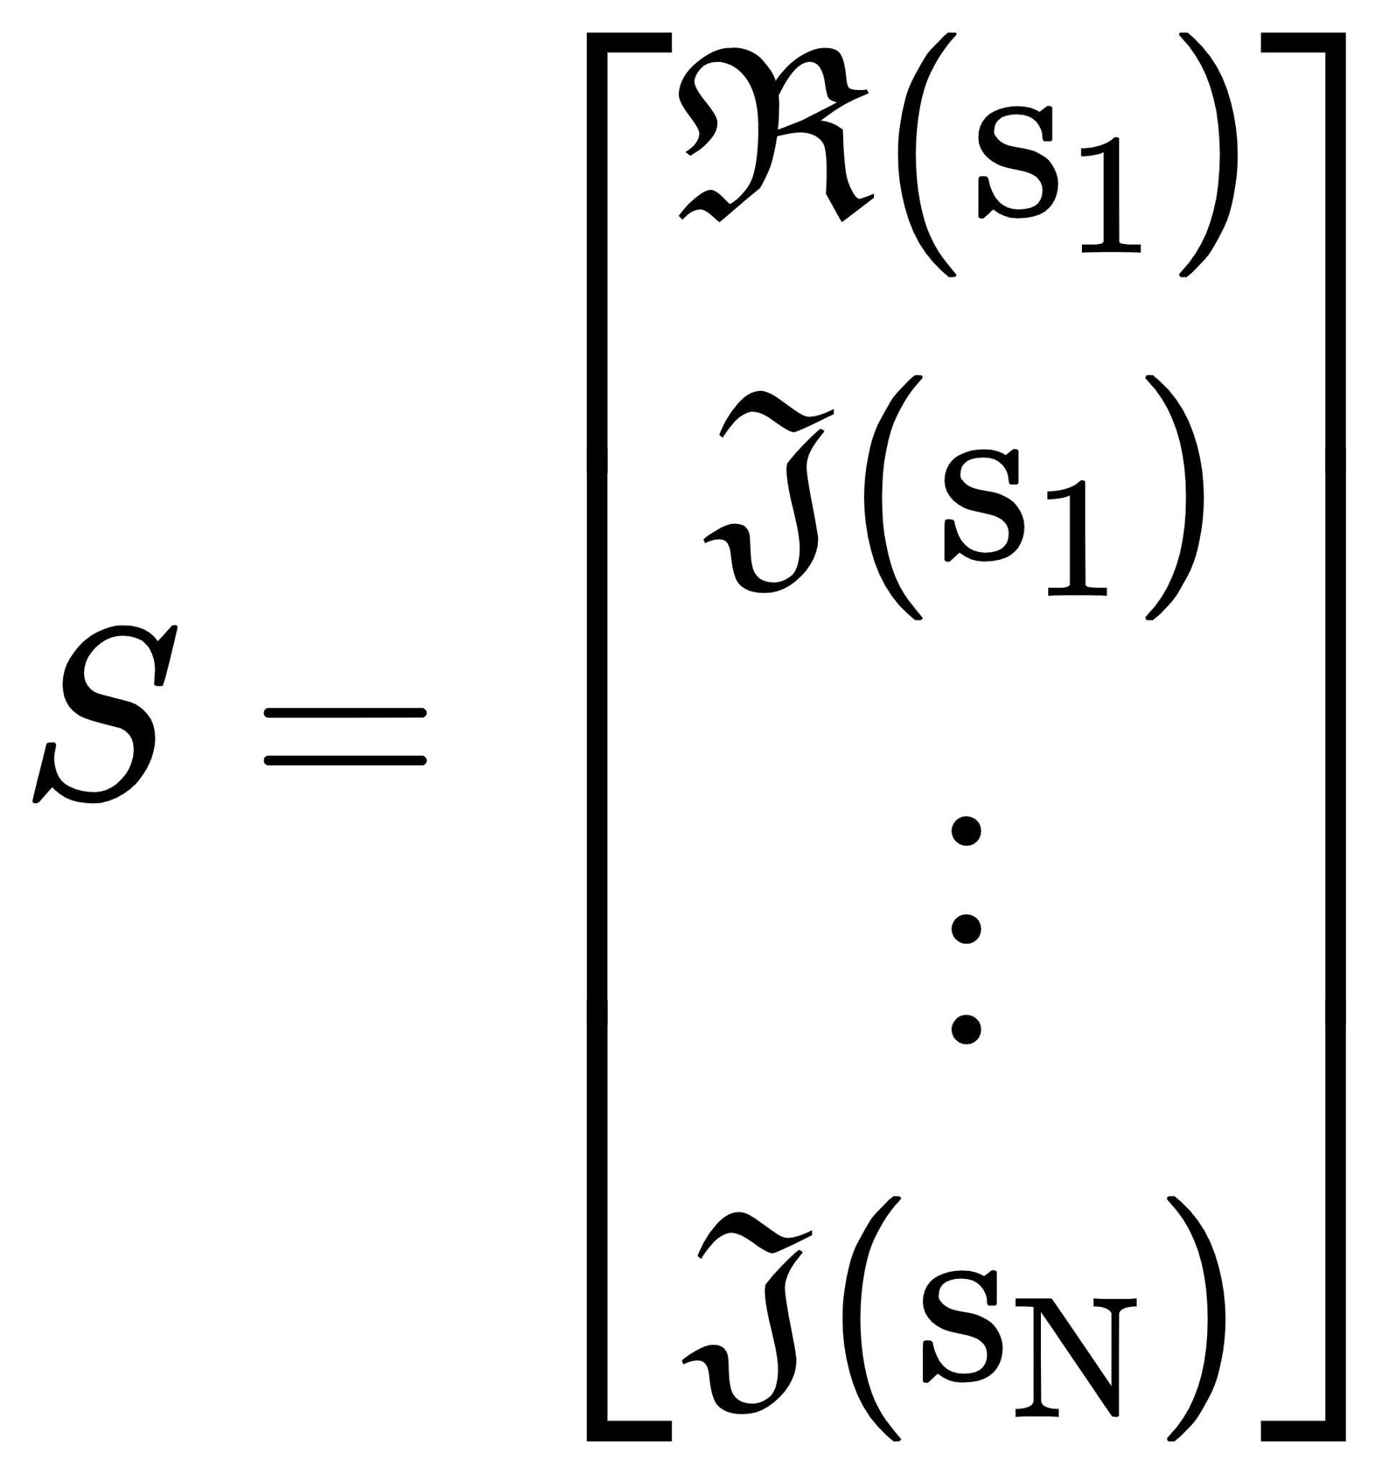
Real Value Signal Model
Notes:
方便計算所以要將實部與虛部做分離
[0618 willy]
Real Signal Model => Real-Valued Signal Model
為了避免誤解為 真實訊號模型

Slide 15
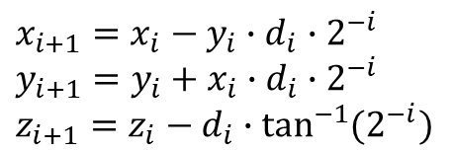
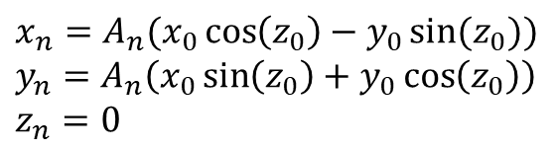
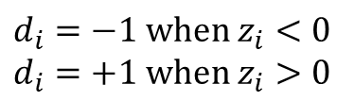
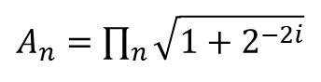
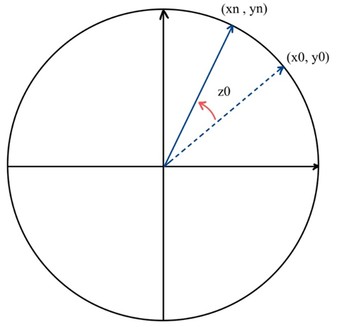
Rotation mode CORDIC
Final result of rotation mode is the
vector position (𝑥𝑛, 𝑦𝑛) with zero angle accumulator

Slide 16
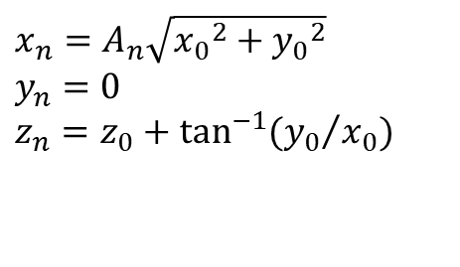
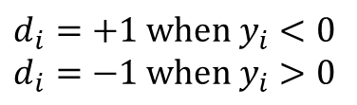
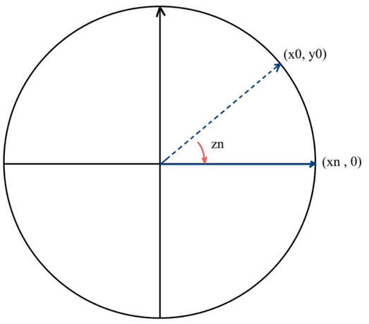
Vector mode CORDIC
Final result of vector mode is rotated angle with
x-coordinate aligned vector

Slide 17
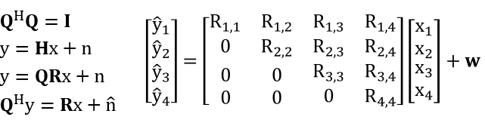
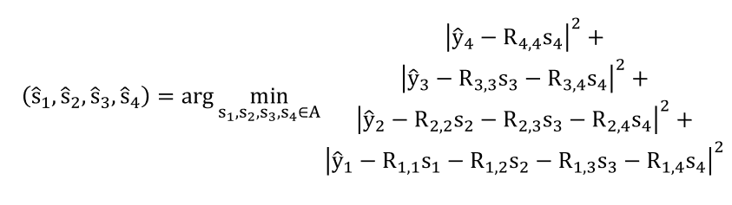
QR decomposition
QR decomposition of channel matrix to reduce the complexity
The MIMO detection problem

Slide 18
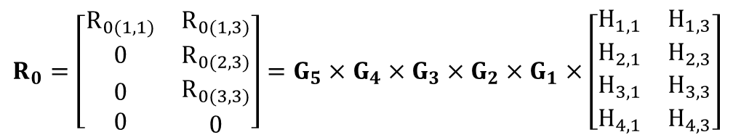
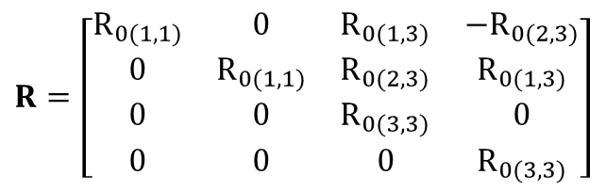
QR decomposition (cont.)
Given Rotation Algorithm

Slide 19
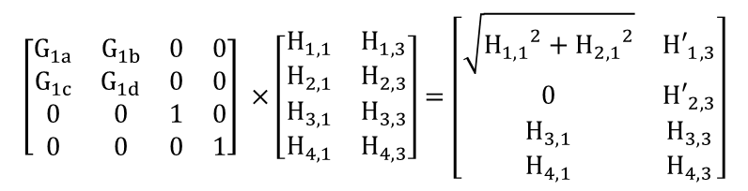
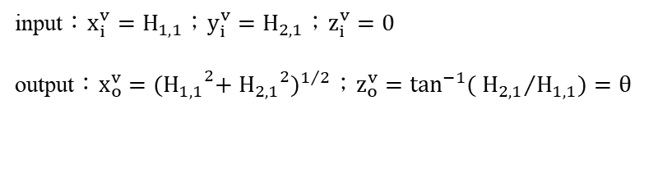
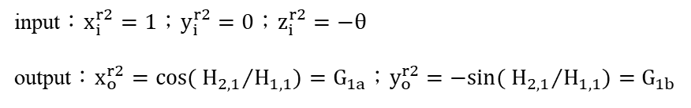
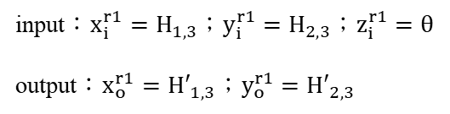
QR decomposition (cont.)
Given Rotation Algorithm with CORDIC
Vector mode
Rotation mode
Rotation mode

Slide 20
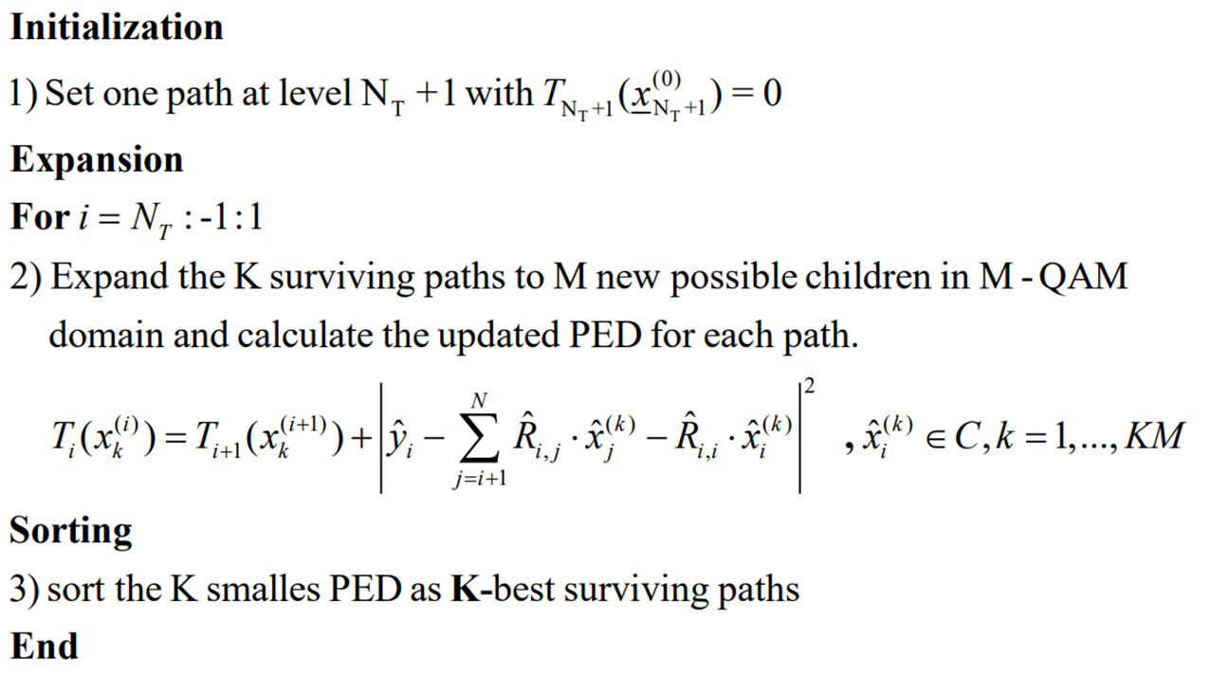
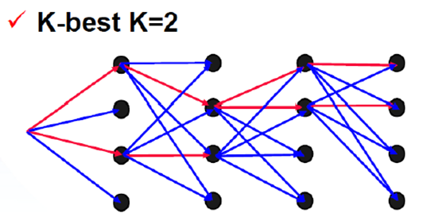
K Best

Slide 21
Outline
Introduction
System Architecture
Algorithm
HLS Implementation
Analysis
Conclusion
Reference
GitHub Link

Slide 22
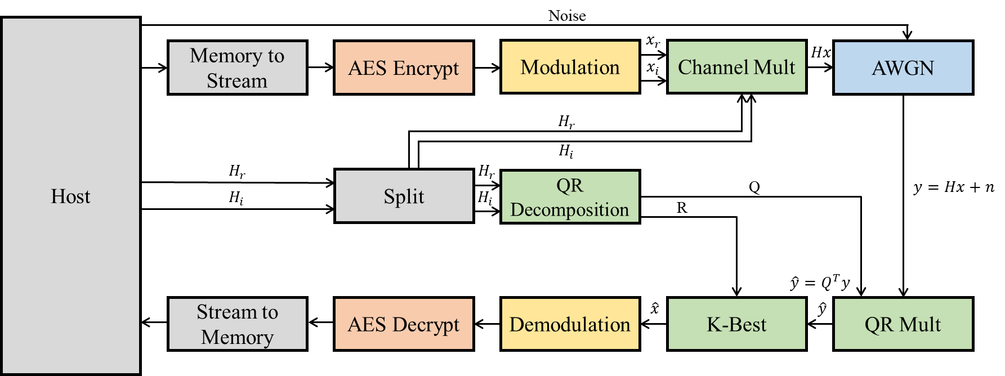
HLS Implementation Architecture

Slide 23
AES-128 algorithm using HLS Implementation
In this project, the HLS can significantly reduce development time compared to traditional development methods.
Our goal is focus on describing the process of obtaining synthesizable C++ descriptions from pure software code.
AES has 10 rounds for 128-bit keys.
The AES-128 algorithm can be optimized by loop unrolling, inner loop and outer loop pipelining techniques to achieve the maximum throughput.
Notes:
尚未整理 0618

Slide 24
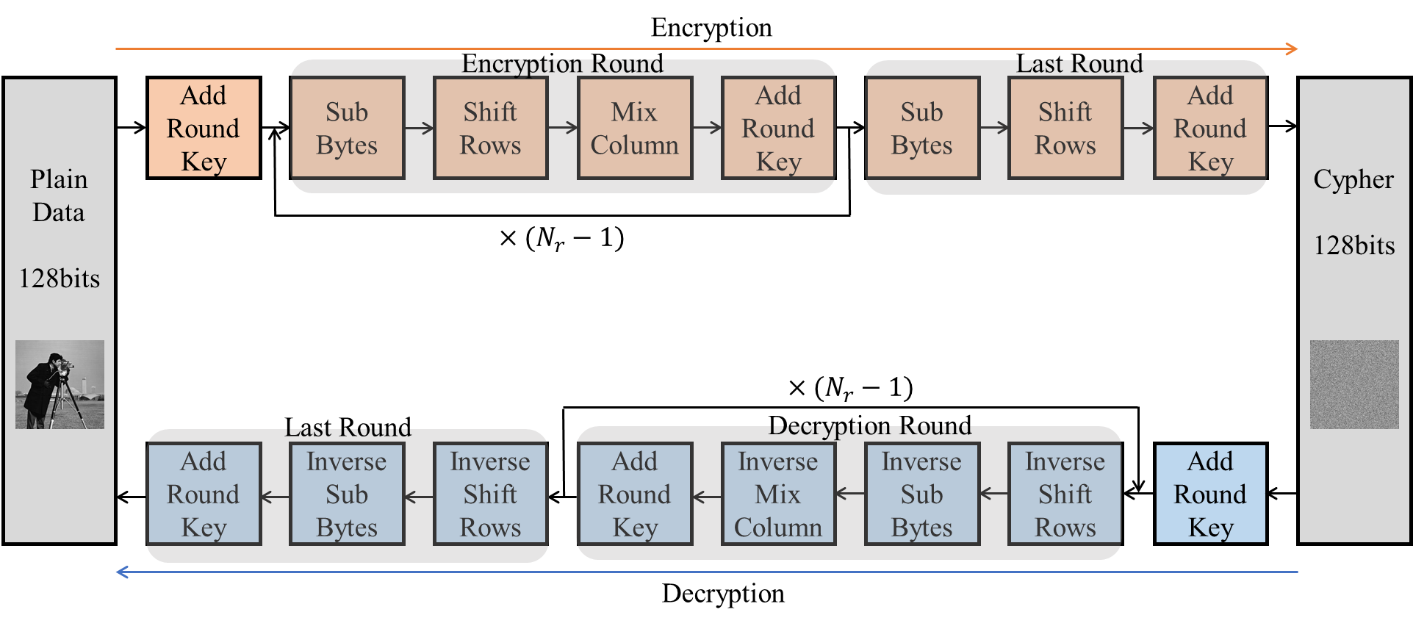
AES-128 algorithm Flow
Notes:
尚未整理 0618

Slide 25
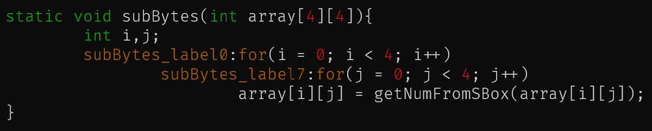
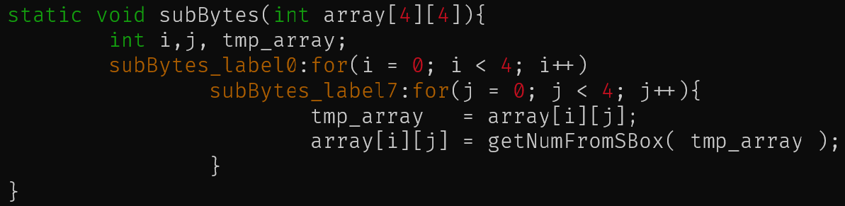
SubBytes
SubBytes is an invertible non-linear transformation.
It uses substitution tables (S-box) for mapping each byte of state into another byte.
Original
Modified
Notes:
ref : https://lisha.ufsc.br/pub/Meurer_SBESC_2013.pdf R. S. Meurer, T. R. Mück and A. A. Fröhlich, "An Implementation of the AES Cipher Using HLS," 2013 III Brazilian Symposium on Computing Systems Engineering, 2013, pp. 113-118, doi: 10.1109/SBESC.2013.36.
產生WAR
array[i][j] => read
getNumFromSBox() => 查表 read
Array[i][j] => write
透過 renaming 解決RAW
以下為補充 不需要說明
The S-box values are generated by computing the multiplicative inverses over in Galois-Field GF(28) and applying affine transformations.

Slide 26
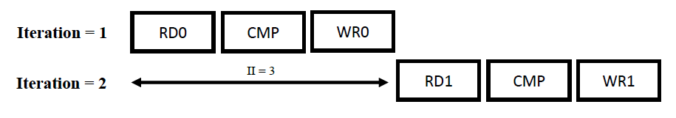
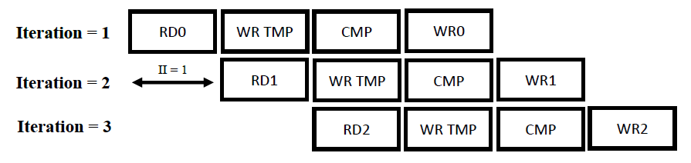
SubBytes Comparsion
Original
Modified
Notes:
比較latency

Slide 27
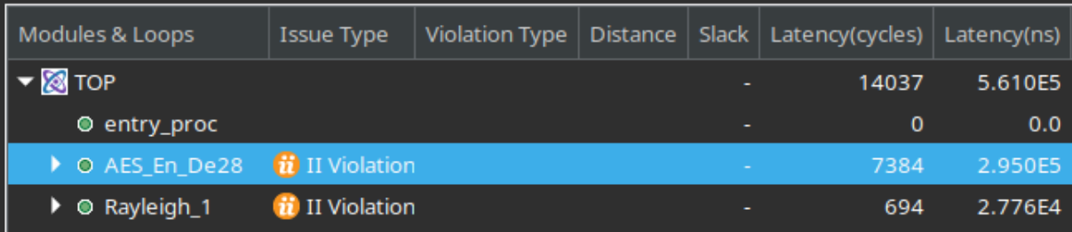
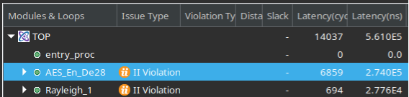
SubBytes Synthesis Comparsion
Original
Modified
Notes:
比較latency

Slide 28
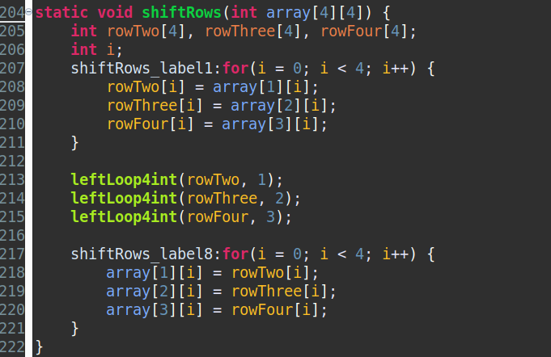
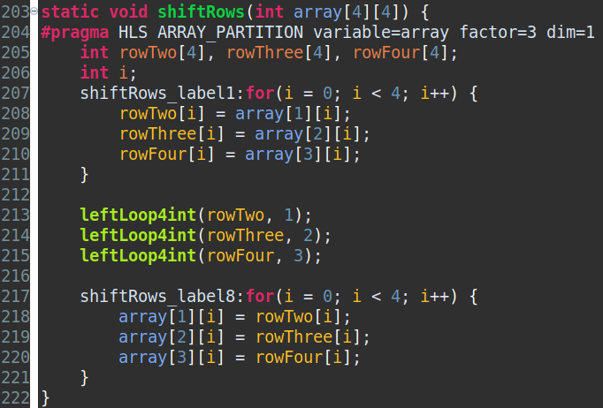
ShiftRows
ShiftRows operation consists basically of a left shift of the second, third and fourth rows of the state matrix by one, two and three bytes respectively.
Original
Modified
Notes:
0618 把modified 這個text , 改到下一張投影片

Slide 29
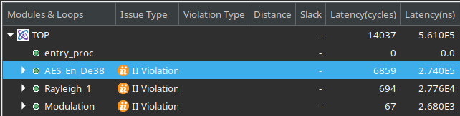
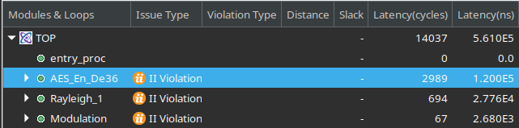
ShiftRows Synthesis Comparsion
Original
Modified

Slide 30
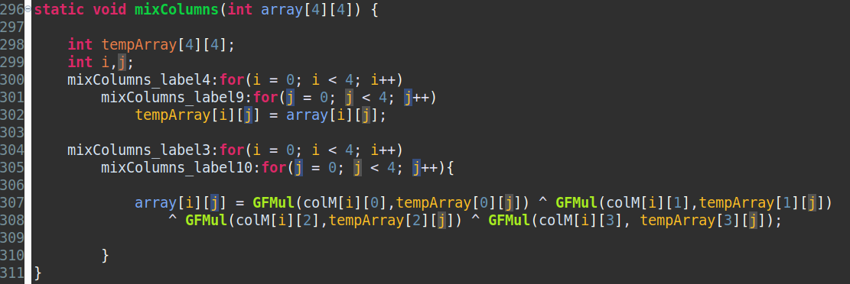
MixColumns
Performs a polynomial multiplication in GF(2⁸) on each column.
Notes:
Performs a polynomial multiplication in GF(2^8) on each column.

Slide 31
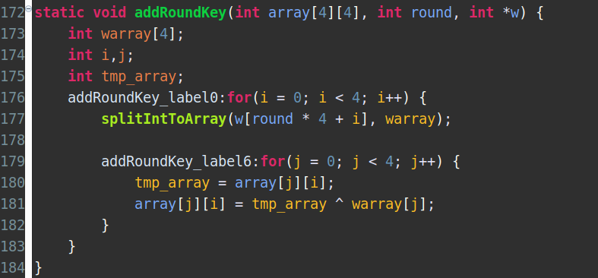
AddRoundKey
AddRoundKey consists in mixing the state array with a round key derived from the cipher key by XOR the bytes in respective positions of the array.

Slide 32
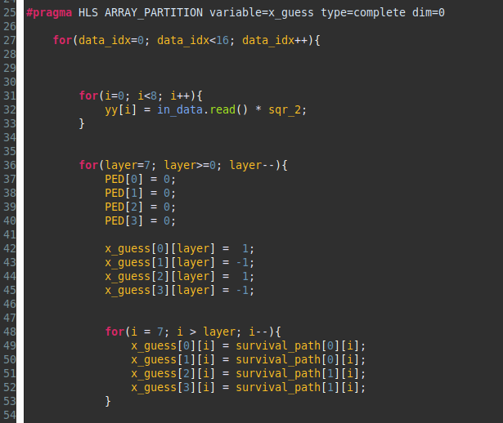
K-Best HLS Implementation
x_guess is the variable which cause the high latency.
Use Array Partition to optimize the LOOP
Notes:
對H[i][j] 優化 無法
反矩陣 做除法反而effort 更大

Slide 33
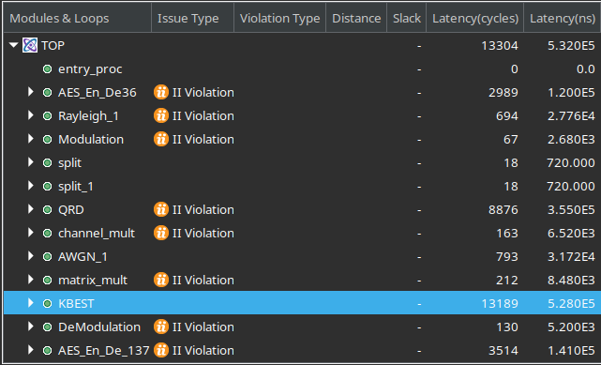
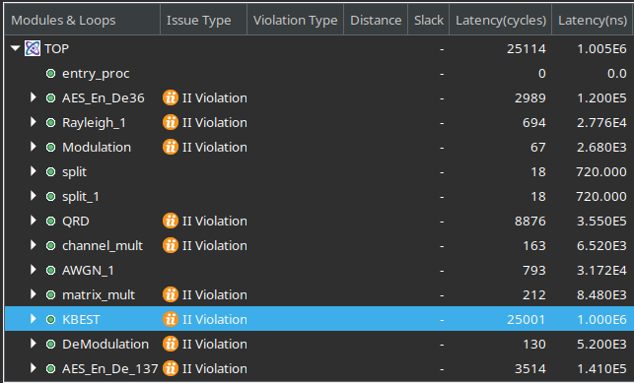


More Reduce on Latency
Total reduce ( 25001 - 13189 ) / 25001 = 47 % latency
Notes:
因為他是最主要的

Slide 34

QR Decomposition
Use "array partition" to increase the amount of read and write ports for the storage.
Use "renaming" to deal the dependency problem

Slide 35



QR Decomposition

Slide 36

CORDIC
Use bit shift to implementation div2
Adjust iteration "k" to improve precision
Use "branch" instead of multiplying ±1
Notes:
0618 把modified 這個text , 改到下一張投影片

Slide 37

System Diagram
Notes:
分析 開發過程所耗的時間成本 與 hls 開發上 優點在哪
現階段問題在哪
以實際的本專案 來佐證

Slide 38

System Utilization(without AES V.S. with AES)
 | LUT(% Used) | Register | BRAM(% Used) | DSP(% Used)
without AES | 59375(6.81%) | 52533 | 25(1.04%) | 167(6.22%)
with AES | 59978(6.88%) | 53780 | 25(1.04%) | 167(6.22%)

Slide 39

Hardware Timeline with AES
The pattern size is 600×600 pixels, that is 600×600×3=1080000 color data, each data has 4 bits. Using AES-128 can encrypt 16 bytes in one iteration so we need 108000÷32=33750 iterations to complete the calculation.

Slide 40

Runtime (without AES)

Slide 41

Runtime (with AES)

Slide 42
Outline
Introduction
System Architecture
Algorithm
HLS Implementation
Analysis
Conclusion
Reference
GitHub Link

Slide 43






Analysis (without AES)
Origin | SNR=0 | SNR=3
SNR=6 | SNR=9 | SNR=12
Notes:
1.SNR數字越小(雜訊越多)，出現的雜點越多
2.會出現連續的錯誤，在SNR12比較明顯，因為此時雜訊較少，主要影響的是通道，其實在雜訊較多的時候也有這種狀況，只是是由雜訊dominate，所以看起來比較不明顯(下一張投影片較明顯)

Slide 44
Analysis (without AES)
SNR=0 dB
SNR=12 dB
Notes:
連續的錯誤，在SNR12比較明顯，因為此時雜訊較少，主要影響的是通道，其實在雜訊較多的時候也有這種狀況，只是是由雜訊dominate，所以看起來比較不明顯

Slide 45






Analysis (without AES)
Origin | SNR=0 | SNR=3
SNR=6 | SNR=9 | SNR=12
Notes:
我們的其他輸入圖片

Slide 46






Analysis (without AES)
Origin | SNR=0 | SNR=3
SNR=6 | SNR=9 | SNR=12
Notes:
我們的其他輸入圖片

Slide 47





Analysis (with AES)
Origin | SNR=0 | SNR=3
SNR=6 | SNR=9 | SNR=12
Notes:
有AES時，當圖片資料有錯誤，會連帶著讓同一組的資料(一組為32筆顏色資料)都出問題

Slide 48
Analysis (without AES V.S. with AES)
SNR = 6 dB
Notes:
在相同的SNR

Slide 49
Outline
Introduction
System Architecture
Algorithm
HLS Implementation
Analysis
Conclusion
Reference
GitHub Link

Slide 50
Conclusion
AES algorithm provides a method with high security and simple encrypt step.
There are a lot of repetitive operations caused by the AES algorithm, so the performance can be improved with the paralleled computing hardware.
HLS can be useful with optimizing loops, pragma PIPELINE help us to speed up development process.

Slide 51
Outline
Introduction
System Architecture
Algorithm
HLS Implementation
Analysis
Conclusion
Reference
GitHub Link

Slide 52
Reference
https://github.com/WilliamsCeng/02Hero
https://blog.csdn.net/qq_28205153/article/details/55798628
https://hackmd.io/@yrHb-fKBRoyrKDEKdPSDWg/HJVX-WH2v
Vitis_Libraries/quantitative_finance/L1/tests/normalRNG at master · Xilinx/Vitis_Libraries (github.com)
https://lisha.ufsc.br/pub/Meurer_SBESC_2013.pdf

Slide 53
Outline
Introduction
System Architecture
Algorithm
HLS Implementation
Analysis
Conclusion
Reference
GitHub Link

Slide 54
GitHub Link
https://github.com/caota985107/HLS_AES_MIMO.git

